Slide 1
DOLLAR TREE NETWORK CONTAINER PROJECT
PRESENTED BY Orange Team

Slide 2



Team Introduction
Pratik Koparde
MS IE
Mruthunjay Mani
MS IE
Namit Patel
MS IE
Mahitha Pulimi
MS MOT

Slide 3

DOLLAR TREE OVERVIEW
Dollar Tree Inc consists of dollar tree stores as well as family dollar stores. Our focus is on dollar tree.
All items in dollar tree our priced at $1.25.
Dollar tree has 15 distribution centres across the US which are used to supply their products to 8180 US stores.

Slide 4
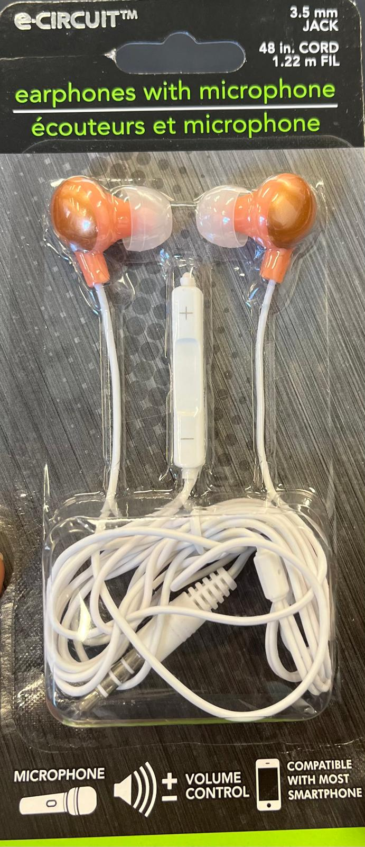
PROJECT OBJECTIVE
The objective is to design a forward supply chain network that delivers 1,000,000 earphones per year from a factory in China to the U.S. market via Dollar Tree Distribution Centers. The target is to achieve a landed cost of less than $0.803 per unit.

Slide 5

PROJECT TIMELINE
OWNER | DELIVERABLES | Sept 17th | Sept 24th | October 1st | October 3rd | October 8th | October 15th | Oct 21st
Mahitha | Echelon Map Musts & Wants Supplier Location | Factory Location and musts and wants | Supplier Selection | Echelon Map | Review with Professor |  |  | Presentation
Pratik | BOM Supplier Selection Mid-bound Logistics Landed Cost | BOM | Supplier Selection | Mid-bound Logistics |  | Landed Cost
Namit | Cross Docking Palletization Distributor Location | Supplier Selection |  | Palletization |  | Cross Docking distributor locations
Mruthunjay | SCCRS Factory Cash to Cash Distributor Cash to Cash Supplier Selection | SCCRS | Supplier Selection | Factory Cash to Cash |  | Distributor Cash to Cash

Slide 6
SUPPLY CHAIN CONSTRUCTION REQUIREMENT SPECIFICATION
ATTRIBUTE | DESCRIPTION
Network Type | Forward Network
Market Segment | Dollar Tree Store Customers
Product Family | Earphones
Product Objective | Design a forward Supply Chain Network Container that sells 1,000,000 units/year of earphones to Dollar Tree for less than 80.3 cents/unit from a factory which is situated in China to the US Dollar Tree DCs.
SPECIFICATION | VALUE | UNITS | VALIDATION
Throughput | 1,000,000 | Units per year | Accepted | Rejected
Factory Cash to Cash | Velocity/Variability | Days +/- , +/- Days | Accepted | Rejected
Factory to Distributor’s Price/Landed Cost | <$0.803 | Dollar per unit | Accepted | Rejected
Distributor to Store Price/Landed Cost | <$1.2500 | Dollar per unit | Accepted | Rejected

Slide 7
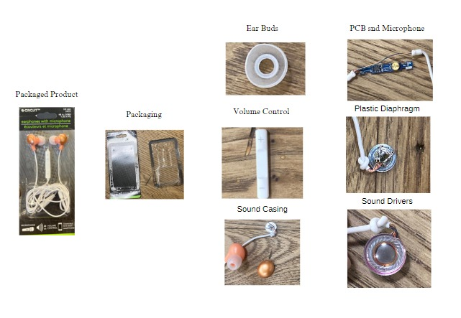
PRODUCT BREAKDOWN

Slide 8
CALCULATED BILL OF MATERIALS
NO. | LEVEL | DESCRIPTION | QTY | UoM | COST ($) | SUPPLIER’S NAME
1 | 0 | Packaged Product | 1
2 | . 1 | Package | 1 | Piece | 0.02 | Dongguan Weida Packaging Product Co., Ltd.
3 | .. 2 | Earphones | 1
4 | … 3 | Plastic Casing for speakers | 2 | Piece | 0.01 | Guangdong Engineering Plastics Industries
5 | …. 4 | Sound Drivers | 2 | Piece | 0.07 | Shenzhen Kaiboer Electronic Technology Co., Ltd
6 | ….. 5 | Wires for connecting drivers | 2
7 | ….. 5 | Plastic Mould | 2
8 | ….. 5 | Plastic Diaphragm | 2
9 | ….. 5 | Magnet | 2
10 | ….. 5 | Copper Wire | 2
11 | ….. 5 | Wire Connecting Terminal | 2
12 | … 3 | Earbuds | 2 | Piece | 0.02 | Shenzhen Jiakang Electronic Co., Ltd
13 | … 3 | Outer Casing | 1 | Piece | 0.01 | Guangdong Engineering Plastics Industries
14 | …. 4 | Microphone (assembled) | 1 | Piece | 0.05 | Shenzhen Kaiboer Electronic Technology Co., Ltd
15 | ….. 5 | PCB | 1
16 | …... 6 | Integrated Circuit | 1
17 | … 3 | 3.5 mm Audio Jack | 1 | Piece | 0.01 | Dongguan Ws Electronic Technology Co., Ltd.
18 | … 3 | Splitter Joint | 1 | Piece | 0.01 | Guangdong Engineering Plastics Industries
19 | … 3 | Wire Insulation and wires | 1 | Meter | 0.01 | Shenzhen Mysun Insulation Materials Co., Ltd.
21 | … 3 | Cable Tie | 1 | PC | 0.002 | Dongguan Chuancheng Plastic and Electronic Co.,Ltd
22 |  | Carton |  | Each | 0.000033 | Shenzhen Leader Display Pdts Ltd.

Slide 9
ECHELON MAP
ECHELON 4
Supplier A
Supplier B
Supplier …
Supplier H
ECHELON 3
Factory
ECHELON 2
ECHELON 1
Customers
Dollar Tree DC 1
Dollar Tree DC 2
Dollar Tree DC …
Dollar Tree DC 15
Dollar Tree Stores

Slide 10
FACTORY SELECTION CRITERIAS
PRIORITY | CRITERIA | VALIDATION | NUMERIC VALUE | STATUS
Must 1 | Transformation Capacity | Right Process? | No of Production Lines: 4 Production Machine: 22 | ✅
Must 2 | Throughput Capacity | Percentage of Throughput | Annual Production Capacity: 40,000,000 Percent of Throughput: 2.5% | ✅
Must 3 | Price/Landed Cost at Volume | Labor Rate? % Overhead? % Factory Markup? Mid-bound Logistics? | $6.35 per hour 100% $ Labor 24% $0.04 | ✅
Must 4 | Product Quality | Quality Philosophy | Inspection of all products CE , RCM, FCC QA/QC Inspection | ✅

Slide 11
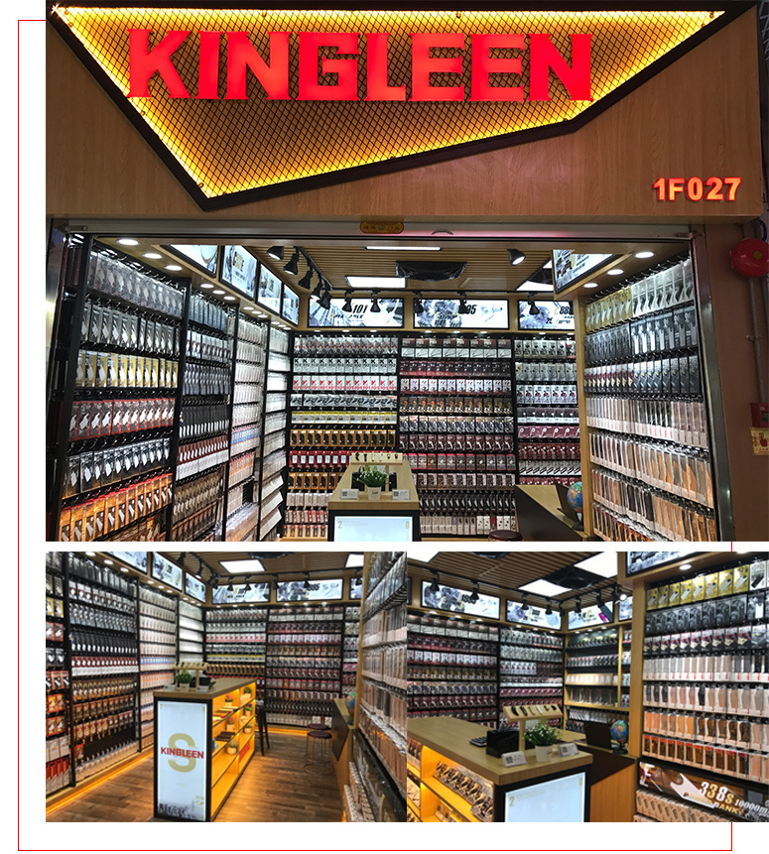
FACTORY SELECTED
NAME | GUANGZHOU KINGLEEN ELECTRONICS CO., LTD
LOCATION | GUANGZHOU, GUANGDONG
FACTORY SIZE | 2200 SQ METRES
BUSINESS TYPE | MANUFACTURER, DISTRIBUTOR
TOTAL EMPLOYEES | 69
ANNUAL OUTPUT VALUE | US $10 Million – US $50 Million
NUMBER OF PRODUCTION LINES | 4
ANNUAL PRODUCTION CAPACITY | 40,000,000

Slide 12
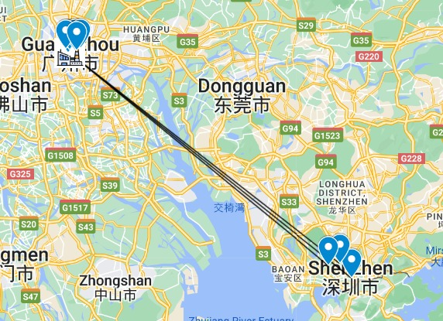
SUPPLIER LOCATIONS
All our suppliers are within the 200 miles established.
The farthest supplier is 85.99 miles away from the factory
Hong Kong is 109 miles from our factory.

Slide 13
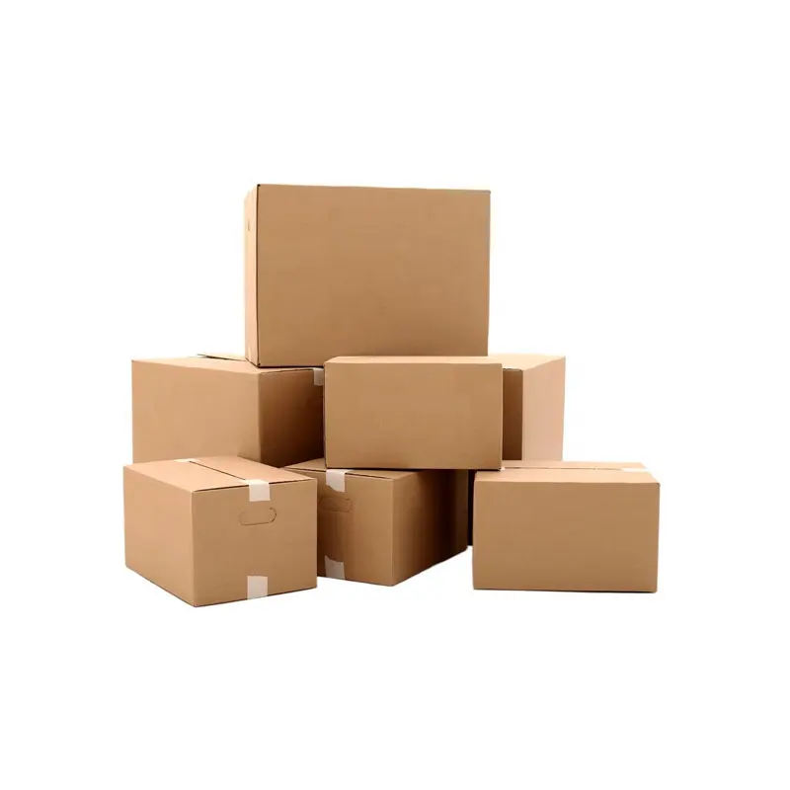
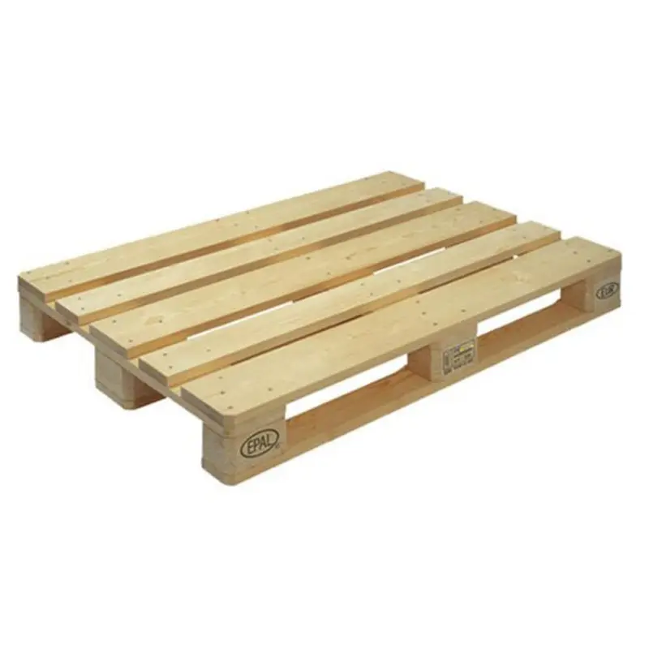
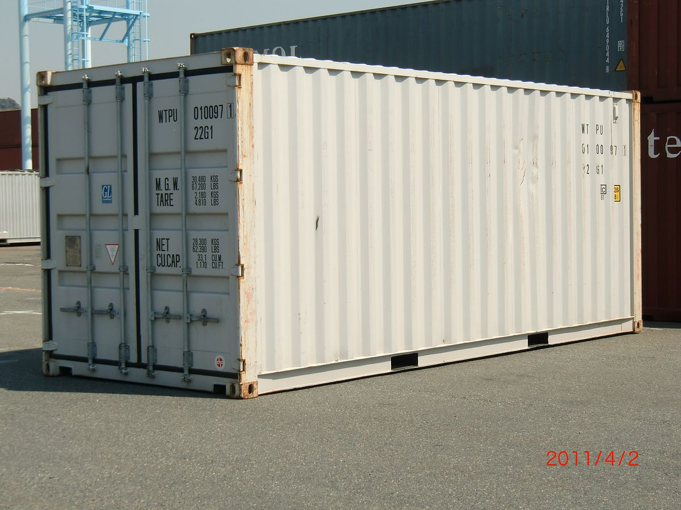
PALLETIZATION & PACKAGING
 | PRODUCT | CARTON | PALLET | CONTAINER
Size (in.) | 4” X 2” X 0.5” | 12" x 10" x 10" | 48" x 40" x 5" | FEU Standard
Weight (lbs.) | 0.05 | 1 | 50 | 36 pallets
No. of Units | 1 | 15*10/0.5 = 300 | 300*48 = 14,400 | 14,400*36 = 518,400
Total Weights (lbs.) | 0.05 | 0.05 * 300 + 1 = 16 | 16*48 + 50 = 818 | 818*36 + 8159 = 37,607
4 Units Per Layer
12 Layers per Carton
48 Units per Carton
0.00208 / Product
Max Pallet Height: 45”
90” Container Door Clearance
Max Pallet Weight: 1,200 lbs.
4*4=16 Cartons Per Layer
3 Layers per Pallet
16*3=48 Cartons per Pallet
Tare wt. = 8,159 lbs.
Max wt. = 67,200 lbs.
Load wt. = 37,607 lbs.

Slide 14
MIDBOUND LOGISTICS
Factory Price
Direct Material Cost | $0.212
5% Inbound Logistics | $0.011
Factory labor Cost | $0.1905
Factory Overhead Cost(100%) | $0.1905
Factory COGS | $0.604
Markup=24% | $0.145
Factory Price/Unit | $0.749
Container Cost/Unit=FEU Cost/units per FEU
Container Cost(Including Drayage) | $4,500
Units per TEU | 518,400
Container Cost/Unit | $0.0077
Duty Cost/Unit=((Factory Price/Unit * Units per TEU)+Container Cost)*%Duty/Units per TEU
Factory Price/Unit | $0.749
Units Per TEU | 518,400
Container Cost/Unit | $0.0077
Import Duty | 4.5%
Duty Cost/Unit | $0.034
Cross-Dock Cost/Unit=(Cross-Docks * Cost per Cross-Dock)/Units per Pallet
Cross Docks | 3
Cost per Cross Dock | $8.50
Units Per Pallet | 14,400
Cross-Dock Cost/Unit | $0.002
Mid-bound Cost | $0.04

Slide 15
PRICE LANDED COST
ECHELON | FACTOR | PRICE/LANDED COST | BUDGET
1 | Demand Landed Cost to the End Customer | Landed Cost | $1.2500
 | Outbound Logistics | Price | 0.0000
2 | Distributor Price=COGS*(1+%Markup) |  | $1.2500
2 | Distributor Markup at 61.3% |  | $0.4580
2 | Distributor COGS=DC Landed Cost+Cross-Docking |  | $0.7920
2 | Distributor Product Cost | Landed Cost | $0.792
 | Mid-bound Logistics | Price | $0.0400
3 | Factory Price=COGS*(1+%Markup) |  | $0.7490
3 | Factory Markup at 22% |  | $0.145
3 | Factory COGS=M+L+O |  | $0.604
3 | Factory Material Cost | Landed Cost | $0.2230
 | Inbound Logistics(including Duty)%5 | Price | $0.011
4 | Supply Price of Direct Materials in the BOM |  | $0.212

Slide 16
CROSS DOCKING
DISTRIBUTION CENTRES | Stockton, CA | Ridgefield, WA | San Bernardino, CA | St. George , UT
Stockton, CA | 0 | 648 | 391 | 636
Ridgefield, WA | 648 | 0 | 1037 | 1079
San Bernardino, CA | 391 | 1037 | 0 | 344
St. George , UT | 636 | 1079 | 344 | 0
TOTAL DISTANCE | 1675 | 2764 | 1772 | 2059
 | Olive Branch, MS | Joilet, IL | Marietta, OK | Warrensburg, MO | Rosenberg, TX
Olive Branch, MS | 0 | 532 | 505 | 423 | 678
Joilet, IL | 532 | 0 | 868 | 440 | 1159
Marietta, OK | 505 | 868 | 0 | 505 | 356
Warrensburg, MO | 423 | 440 | 505 | 0 | 780
Rosenberg, TX | 678 | 1159 | 356 | 780 | 0
TOTAL DISTANCE | 2138 | 2999 | 2234 | 2148 | 2973
 | Chesapeake, VA | Savannah, GA | Briar Creek, PA | Windsor, CT | Cherokee County, SC | Marengo, OH
Chesapeake, VA | 0 | 484 | 423 | 485 | 382 | 617
Savannah, GA | 484 | 0 | 791 | 922 | 251 | 711
Briar Creek, PA | 423 | 791 | 0 | 247 | 612 | 392
Windsor, CT | 485 | 922 | 247 | 0 | 799 | 639
Cherokee County, SC | 382 | 251 | 612 | 799 | 0 | 512
Marengo, OH | 617 | 711 | 392 | 639 | 512 | 0
TOTAL DISTANCE | 2391 | 3159 | 2465 | 3092 | 2556 | 2871

Slide 17
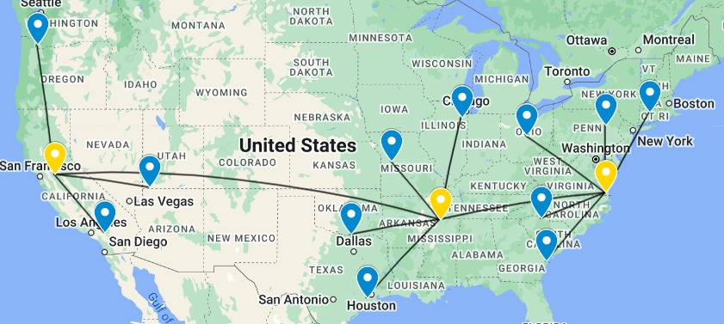
Stockton, CA to Olive Branch, MS | 2062
Olive Branch, MS to Chesapeake | 930
TOTAL CROSS DOCKING DISTANCE | 2992

Slide 18
FACTORY CASH TO CASH CYCLE
C
Net 30d
Factory Supply O-D-C
Factory must pay Supplier before getting paid by customer
O | LT | TT
1d | - | 1d
2d
Factory make
- - -
M | INV
11 | 35±10
C
Net 30d
- - -
- - -
Factory Demand O-D-C
O | Pick n Pack
1d | 1d
2d
O = Order Time
LT = Lead Time C
T = Transit Time
C = Time to Cash M = Make Time
Inv = Inventory Holding Time
Cash-to-cash cycle velocity = -30d + (1d +11d +35d +1d +30d) = +48 days
Cash-to-cash cycle variability = Inventory holding time variability = +/-10 days

Slide 19
DISTRIBUTOR CASH TO CASHCYCLE
Dollar Tree Information from Form 10-K
Net Sales | $30,581.6 million
Dollar Tree Sales | $16,770.3 million
Dollar Tree Gross Profit | $6,008.9 million
Dollar Tree COGS | $10,761.4 million
%Dollar Tree | 54.83%
Merchandise Inventories | $2,586.54 million
Account Payable | $1,044.07 million
Distributor Cash to Cash Cycle
Days of Inventory | 87.73 days
Days of Receivable | 0 days
Days of Payable | 35.41 days
Days of Cash Conversion | 52.32 days
Days of Inventory = ($Inventory x 365 Days) / $Annual COGS = ($2,586.54 x 365 Days) / $9,318.50 = 87.73 days
Days of A/R = ($A/R x 365) / $Annual Revenue = 0 days
(As customers must make full payment while buying the product)
Days of A/P = ($A/P x 365 Days ) / $Annual COGS = ($1044.07 x 365 Days ) / $10,761.4 = 35.41 days
Days of Cash Conversion = Days of Inventory + Days of Receivables - Days of Payables = 87.73- 35.41 = +52.32 days

Slide 20

SUPPLY CHAIN CONSTRUCTION REQUIREMENT SPECIFICATION
ATTRIBUTE | DESCRIPTION
Network Type | Forward Network
Market Segment | Dollar Tree Store Customers
Product Family | Earphones
Product Objective | Design a forward Supply Chain Network Container that profitably sells 1,000,000 units/year of earphones to Dollar Tree for less than 80.3 cents/unit from a factory which is situated in China to the US Dollar Tree DCs.
SPECIFICATION | VALUE | UNITS | VALIDATION
Throughput | 1,000,000 | Units per year | Accepted | Rejected
Factory Cash to Cash | Velocity/Variability | +48 Days, +/- 10 Days | Accepted | Rejected
Factory to Distributor’s Price/Landed Cost | $0.792<$0.803 | Dollar per unit | Accepted | Rejected
Distributor to Store Price/Landed Cost | < $1.2500 | Dollar per unit | Accepted | Rejected

Slide 21
SUMMARY
Using the Dollar Tree Distribution Network, the Orange Team has successfully developed a supply chain network to distribute Earphones made in China for sale in the United States.
REQUIRED | ACHIEVED | STATUS
Competitive Price from Suppliers for Raw Materials | $0.212 per unit
Distance between suppliers and factory <200 miles. | Maximum distance between supplier and factory is 85.99 miles
Throughput: 1,000,000 per year | Throughput: 1,000,000 per year
Factory Selection Satisfying Musts | Selected Factory meets the following:- Transformation Capability, Throughput Capacity, Price/Landed Cost at Volume and Product Quality
Low Mid-bound Cost and Optimized Palletization | Ocean Freight: $0.04 518400 products per container
Distribution Price: < $0.803 per unit | Distribution Price: $0.792 per unit.

Slide 22
THANK YOU

